Slide 1
Survey of IoT Ecosystem Components
Group 1 –
Hamza Karachiwala
Hiranava Das
Rahul Bobhate
Sharique Hussain
Suryansh Singh

Slide 2
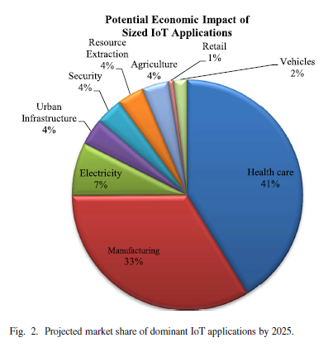
Why have this survey?
Scope of IoT
Vertical domain markets
Horizontal domain agnostic markets
Vast field
Devices, applications and communication
Architectures, protocols and standards
Challenges and research
Security, trust
Management, performance, reliability
Market Value
Massive growth projection
$3 trillion - $6trillion value by 2025

Slide 3
IoT : Survey of Enabling Tech, Protocols, Applications
Al-Fuqaha, Guizani, Mohammedi, Aledhari, Ayyash
IEEE COMMUNICATION SURVEYS & TUTORIALS
2015

Slide 4
We will cover
Architecture
5 layer architecture
Elements
Processes in a solution
Protocols
Application
Service Discovery
Infrastructure
Research Challenges
Requirements
Big data
Analytics
Cloud and Fog
Horizontal Integration
Communication between solutions

Slide 5
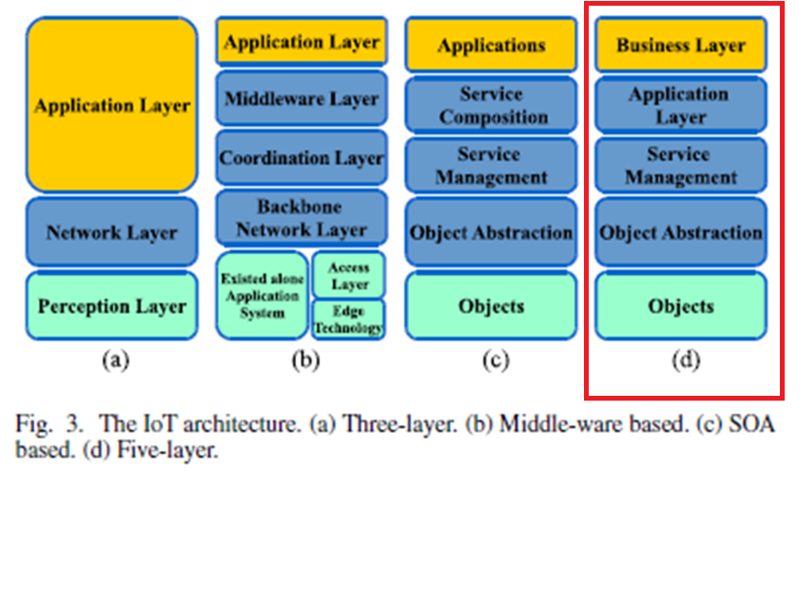
Architecture
Business use case
User Services
Data accessed by services
Deliver data to repository
Devices – sensors / actuators

Slide 6
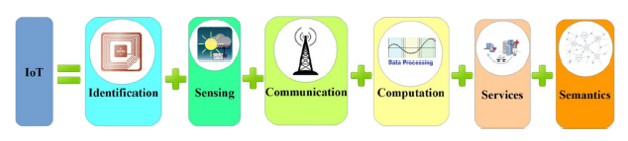
IoT Elements

Slide 7
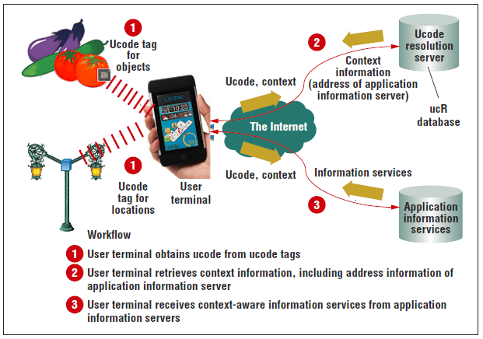
Identification
Unique identification is important to match service with demand.
Electronic product codes and ubiquitous codes are available.
Understanding the difference between network address and object ID is important.
Together the object ID and network address helps uniquely identifying an IoT object.
Ubiquitous ID: Standards for Ubiquitous Computing and the Internet of Things Noboru Koshizuka and Ken Sakamura

Slide 8
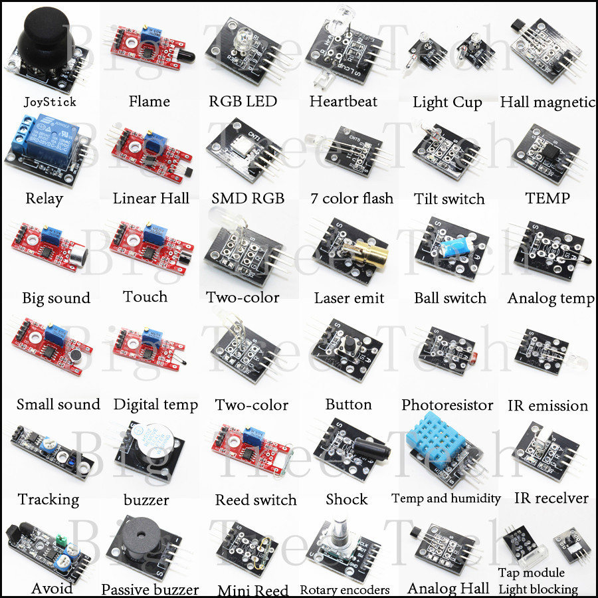
Sensing
IoT sensing is collections of similar data from different sensors and sending the information to data warehouse, database or cloud.
The collected data is analyzed and actions are taken accordingly.
Single Board Computers (SBCs) integrated with sensors, TCP/IP and security functionalities together make an IOT device

Slide 9
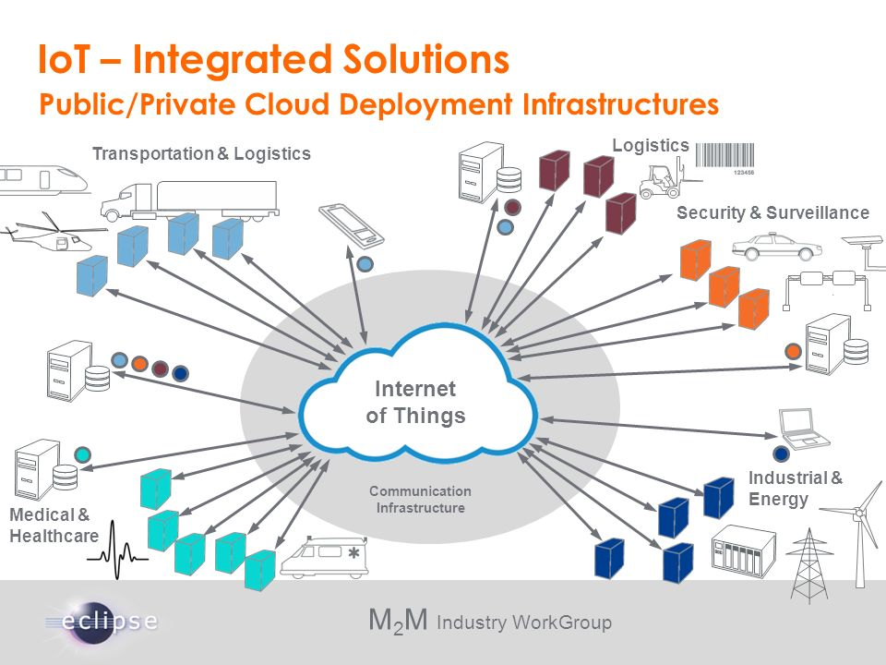
Communication
IoT communication faces mainly two challenges
Connecting varied types of IoT objects
Consuming very less power
Different technologies for IoT communication are
RFID tag and reader realizes the M2M concept.
NFC and Ultra wide bandwidth.
Bluetooth 4.1 or Bluetooth Low Energy.
Wi-Fi using radio waves and router.
LTE the standard protocol for high speed data transfer in mobile phones.

Slide 10
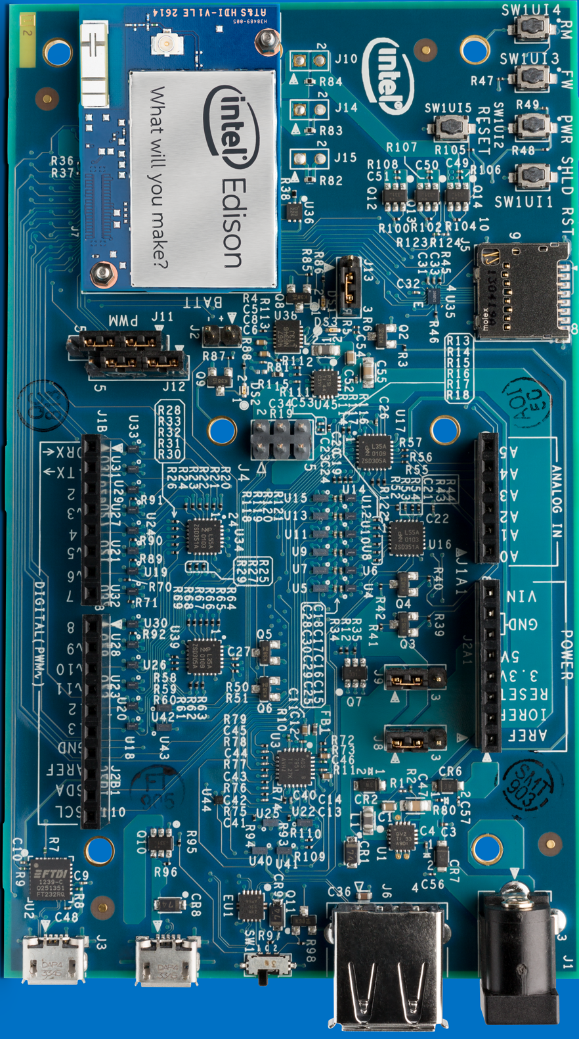
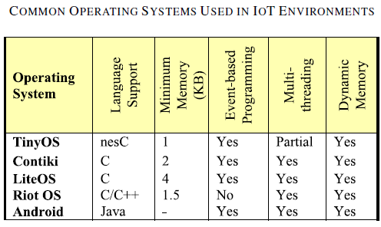
Computation
The “brain” of an IoT object.
Different hardware are available in market like Arduino, Intel Edison etc.
Operating system running on these hardware is of crucial importance
Cloud platform is also an important part of computation. It facilitates collection and processing of big data.

Slide 11
Services
Identity related services
Identify real life objects in virtual world
Information aggregation services
Collect and summarize raw sensory data
Collaborative-Aware services
Make decisions and respond
Ubiquitous services
Any time, anyone and anywhere
Smart home, Smart buildings, Intelligent Transport System, Industrial Automation, Smart Healthcare and Smart Grids.

Slide 12
Semantics
Make sense from the gathered information and provide services accordingly.
Discovering and using resources

Slide 13
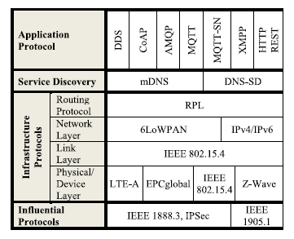
Protocols

Slide 14
Application protocols
Constrained Application protocol (CoAP)
Message Queue Telemetry Transport (MQTT)
Extensible Mapping and Presence protocol (XMPP)
Advanced Message Queuing Protocol (AMQP)
Data Distribution Service (DDS)

Slide 15
Protocols

Slide 16
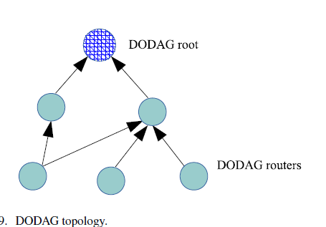
Routing Protocol for Low Power and Lossy Networks(RPL)
Link independent routing protocol based on IPv6 for resource constrained nodes.
Destination Oriented Directed Acyclic Graph forms the core.
Problems
Under Specification
Incompatibility of modes in storing and non storing modes
High overhead
Unreliability

Slide 17
6 low Power wireless Area Network
IPv6 over low power wireless area network to support IPv6 network
Provides header compression which reduces overhead
Supports fragmentation to accommodate IPv6 Maximum Transmission Unit (MTU)
Supports multi-hop delivery
Four types of headers (00) No 6lowPAN, (01) Dispatch Header, (02) Mesh Addressing, (03) Fragmentation
Problems
Round trip delay when ICMP payload is increased
High rate of packet loss
Ease of interference

Slide 18
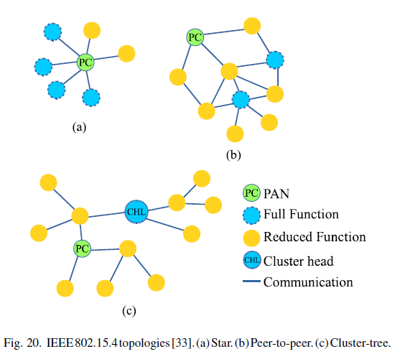
IEEE 802.15.4
The IEEE 802.15.4 has lot advantages like low power consumption, low data rate, low cost, high message throughput, good reliability and interoperability.
High level of security, authentication services and encryption
Problems
No QoS guarantee

Slide 19
More protocols
Bluetooth Low Energy
EPC Global
LTE-A
Z-Waves

Slide 20
Challenges
Availability
Access to hardware and software
Reliability
Dependability of hardware and software
Mobility
Delivery and management
Performance
Components and protocols
Management
Light weight FCAPS of billions of devices
Interoperability
Applications and devices
Security and Privacy
CIA among smaller devices

Slide 21
Big Data Analytics in IoT
Volume of data
Everything is connected and producing data
Cannot keep upgrading hardware to keep this data
What to do with it
Will just be a huge collection of readings
Need to find patterns
Patterns should provide knowledge
Knowledge should be monetized!
Takeaway –
Analyze
Scale

Slide 22
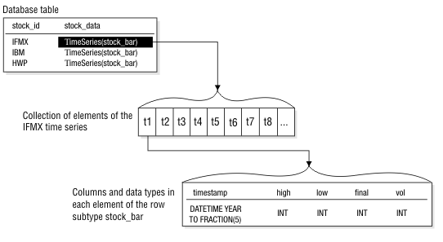
Analytics
Available tools usually fall short
Facebook Hadoop version
TSaaaS for IoT
IoT data real time
Time Series Database
Optimized for IoT
Faster pattern recognition
Why keep all data
Pattern reduction, feature selections

Slide 23
Cloud Platform and Services
Cloud computing
Scalability = cloud!
Has its own set of challenges because of variety in cloud providers
Synchronization of data between different vendors
Standardization of data and services within vendors
Security mechanisms differ according to the vendors
Xively – host IoT
PaaS
Manage sensor data on web
Connect with devices easily using APIs
Enables users to visualize data graphically

Slide 24
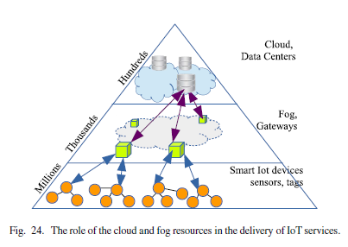
Fog Computing
Fog computing
Also called cloudlets or edge computing
Bridge between small devices and large cloud
Reduce delay, increase scale
Act as microcenters
Significant difference in cloud and cloudlets in terms
Storage
Computation power
Provides better performance for real-time services like real-time analytics

Slide 25
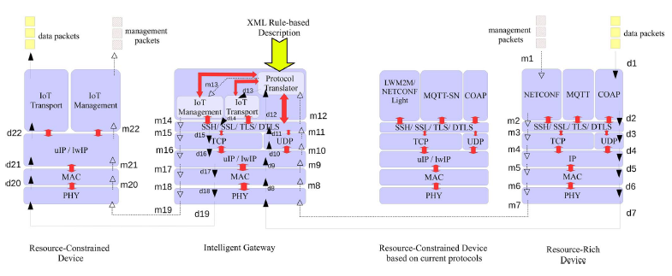
Horizontal Integration between Application Protocols
Problem : Communication between resource rich and resource constrained devices.
Solution: Intelligent Gateway

Slide 26
Thank You!

